Slide 1
Introduction to ReactJS

Slide 2
Objectives
Overview React
Setting Up the Development Environment
Scaffold out a starter React application using Vite – a build tool.

Slide 3
What is React?
A declarative, efficient, and flexible JavaScript library for building user interfaces.
Created by Facebook (now Meta) and a large community of developers.
Used to build single-page applications (SPAs) and mobile applications.
Focuses on component-based architecture for building reusable UI elements.

Slide 4
React: A Versatile JavaScript Library
While React is often referred to as a framework, it's technically a JavaScript library
React is just the view layer
Simplicity is good
Declarative UI structures
Data changes over time
Performance matters
The right level of abstraction

Slide 5
Key Features of ReactJS
JSX: Explain how JSX allows developers to write HTML-like syntax within JavaScript, making UI code more readable and maintainable.
Components: Illustrate how React applications are built using reusable components, which manage their own state and rendering logic.
Virtual DOM: Explain how React uses a virtual DOM to efficiently update only the necessary parts of the actual DOM, improving performance.
One-way Data Binding: Describe how data flows in one direction in React, making it easier to understand and debug applications.
React Native: Build native mobile apps using React's principles.

Slide 6
What is Node.js
Node.js is a powerful, open-source JavaScript runtime built on Chrome's V8 JavaScript engine.
It allows developers to run JavaScript code outside the web browser, on the server-side, enabling JavaScript to be used for both client-side and server-side development.

Slide 7
Node.js Main Features and Functions - 1
JavaScript Runtime
Node.js is not a programming language itself but an environment where you can run JavaScript. Traditionally, JavaScript was used only in browsers to handle client-side tasks like user interaction and UI updates.
Node.js extends JavaScript to the server-side, allowing you to build backend applications.
Built on V8 Engine
Node.js uses Google’s V8 JavaScript engine (the same engine used in Google Chrome) to execute JavaScript code quickly and efficiently.
V8 compiles JavaScript to machine code at runtime, which increases the speed of Node.js applications.

Slide 8
Node.js Main Features and Functions - 2
Event-Driven and Non-Blocking I/O
Node.js is asynchronous and non-blocking. This means that instead of waiting for operations like reading files or querying databases to finish, Node.js can handle other tasks while waiting for the operation to complete. This feature allows Node.js to handle many tasks concurrently, making it highly scalable and efficient.
Event-driven architecture: Node.js uses events and callbacks to handle operations, which helps in managing tasks like I/O operations (file reading, database queries, etc.) without blocking other processes.

Slide 9
Node.js Main Features and Functions - 3
Single-Threaded
Although Node.js operates in a single-threaded model, it can handle thousands of concurrent connections without creating additional threads. This is due to its event-driven, non-blocking architecture. The single thread uses an event loop to manage multiple tasks efficiently.
npm (Node Package Manager)
One of the key aspects of Node.js is npm, its built-in package manager. npm allows developers to easily install, share, and manage libraries (also known as packages) used in Node.js projects.

Slide 10
Node.js Main Features and Functions - 4
Applications
Web servers and APIs: Node.js is commonly used for building backend web servers or RESTful APIs. Its asynchronous nature makes it great for handling multiple requests concurrently.
Real-time applications: Node.js is used in applications that handles real-time data transfer.
Single-page applications (SPA): Node.js is often used alongside frameworks like React, Angular, or Vue for building SPAs.
Cross-Platform - Node.js is cross-platform, meaning it works on various operating systems, including Linux, macOS, and Windows.

Slide 11
Node Package Manager
Node package manager (NPM): manages ecosystem of node modules / packages
A package contains:
JS files
package.json (manifest)
npm is the standard package manager for Node.js.

Slide 12
Initializing package.json
To initialize a package.json file for your project, type at the prompt in your project directory:
npm init / npm init -y
If a project has a package.json file, by running
npm install
Can install a specific package by running
npm install <package-name>
Ex: npm i bootstrap@5.3.1

Slide 13
Using npm
As for the optionalDependencies the difference is that build failure of the dependency will not cause installation to fail.
See more flags added to this command:
--save -dev installs and adds the entry to the package.json file devDependencies
--no-save installs but does not add the entry to the package.json file dependencies
--save-optional installs and adds the entry to the package.json file optionalDependencies
--no-optional will prevent optional dependencies from being installed
--save --force attempting to install or update dependencies that may cause conflicts or compatibility issues

Slide 14
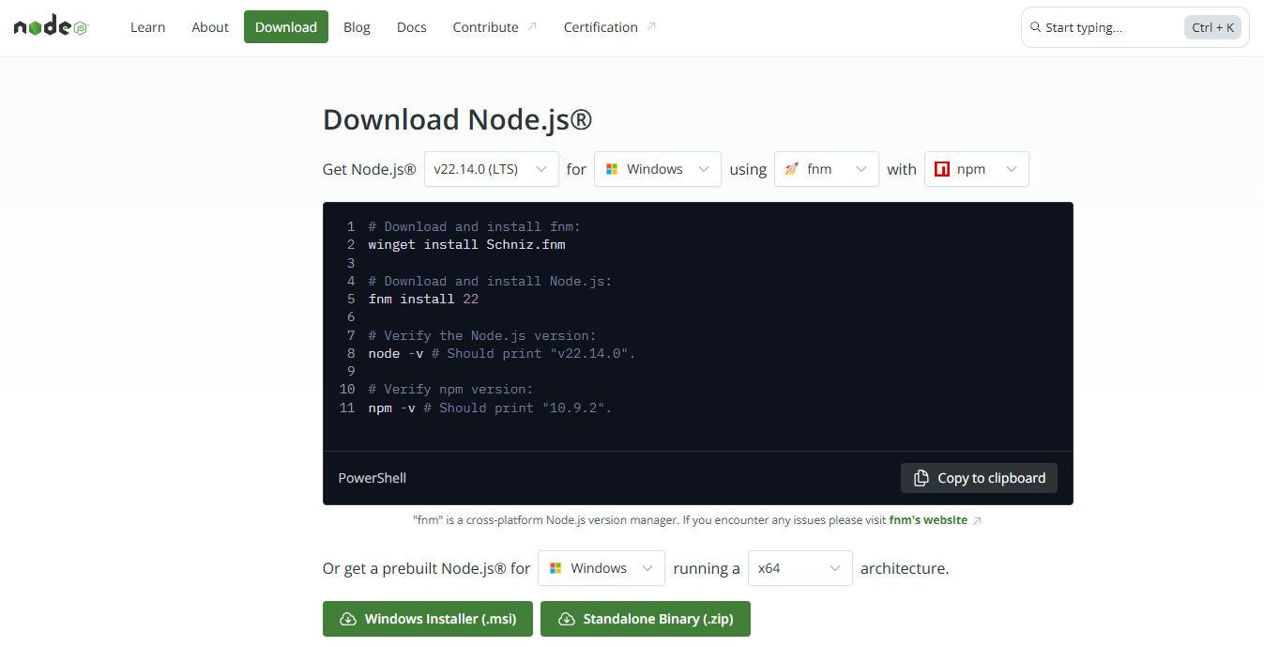
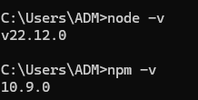
Setting Up the Development Environment - 1
Install Node.js and npm:
Download Node.js from the official website (nodejs.org).
Node.js comes with npm (Node Package Manager) bundled.
Node Package Manager (npm):
npm is used to manage project dependencies.
Check version of node and npm:
node –v
npm -v

Slide 15
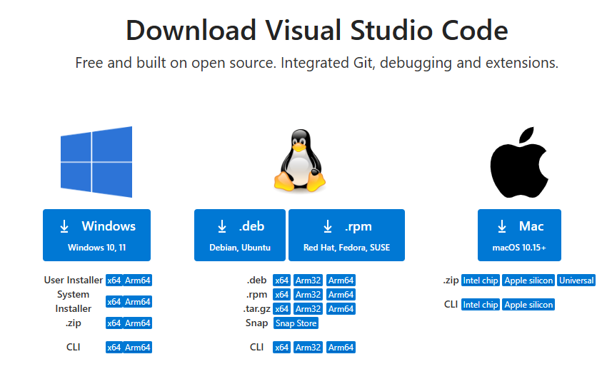
Setting Up the Development Environment - 1
Download VS Code IDEA:
https://code.visualstudio.com/Download

Slide 16
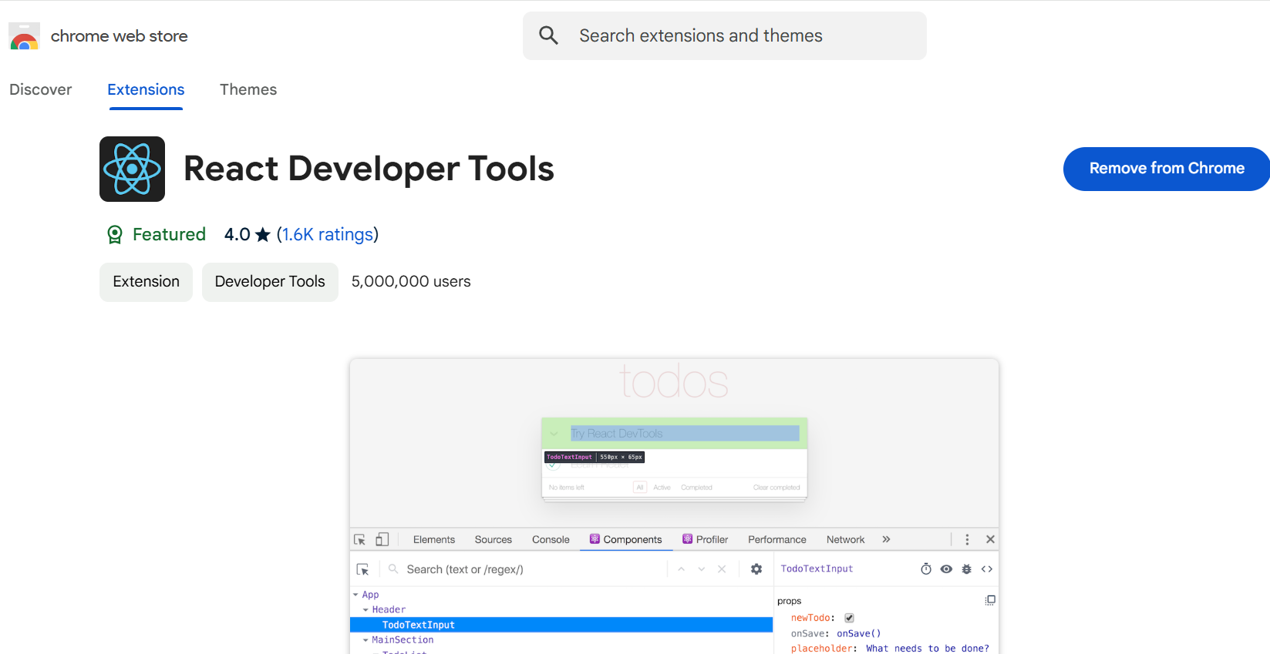
Setting Up the Development Environment - 2
Chrome Dev Tools: https://chrome.google.com/webstore, add React Developer Tools

Slide 17
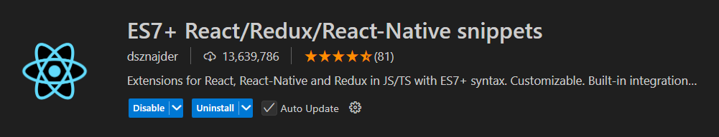
Setting Up the Development Environment - 3
VS code Extensions for React: ES7+ React/Redux/React-Native snippets

Slide 18
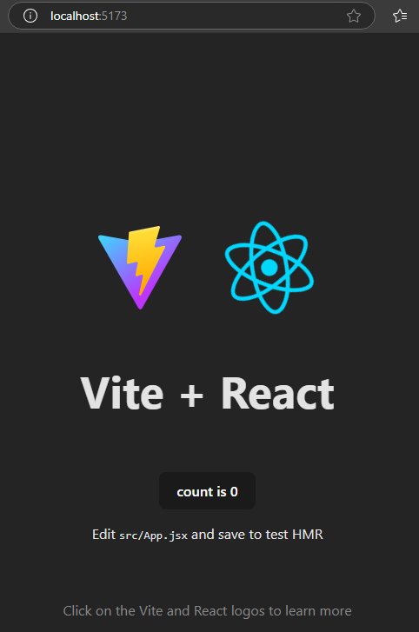
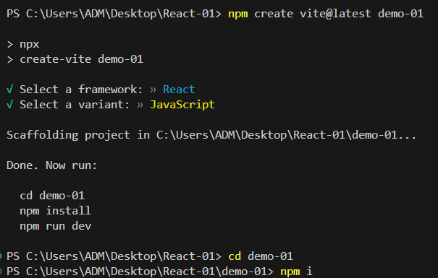
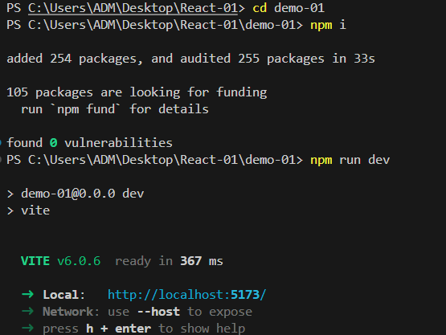
Demo - Create new React App by using Vite
Type: npm create vite@latest name-of-project
3
1
2

Slide 19
Git
Version Control: software tool(s) that enable the management of changes to source code
Maintaining version history
Several version control tools: CVS, SVN, Git etc.
Distributed version control system
Developed by Linus Torvalds for managing Linux kernel development
Widely adopted now by several projects
The Node ecosystem thrives on it

Slide 20
Git Install - 1
Download Git to your computer at: https://git-scm.com/downloads
Choose the Git version that is suitable for the operating system you are using on your computer and download it.
Open the installation file and run the setup program.
Agree to the terms and continue the installation process.
Choose the installation options that you want to use and continue the installation process.

Slide 21
Git Install - 2
Complete the installation process and restart your computer if required.
Open Command Prompt or Terminal on your computer and check if Git has been successfully installed by entering the following command:
git --version
If Git has been installed successfully, the version of Git will be displayed on Command Prompt or Terminal.

Slide 22
Online Git Repository
Configure Git git config --global user.name "yourname " git config --global user.email "youremail"
Creating Git Folder cd myproject
Initialize Git git init

Slide 23
Using Git - 1
Add the remote online repository git remote add origin <repository URL>
Git Staging Environment git add ‘your file name’ git add --all
Check status git status
Git Commit git commit -m "First of Hello World!"

Slide 24
Using Git - 2
Git Commit Log
git log
New Git Branch git branch ‘hello-world’
Git Checkout git checkout hello-world
Push Changes to GitHub git push -u origin master

Slide 25
History of React
2011: Initial Release (Facebook's internal use)
2013: Open-sourced at JSConf US
2015: React Native is released (for mobile app development)
2016: React Fiber introduced for performance improvements.
2017: React Fiber (improved rendering engine)
2020: React 17 released with focus on stability and compatibility.
2022: React 18 released with concurrent rendering and Suspense.
Present: Continued development with regular updates and improvements.

Slide 26
Summary
Concepts were introduced:
Overview React
Setting Up the Development Environment
Scaffold out a starter React application using Vite – a build tool.

